Slide 1
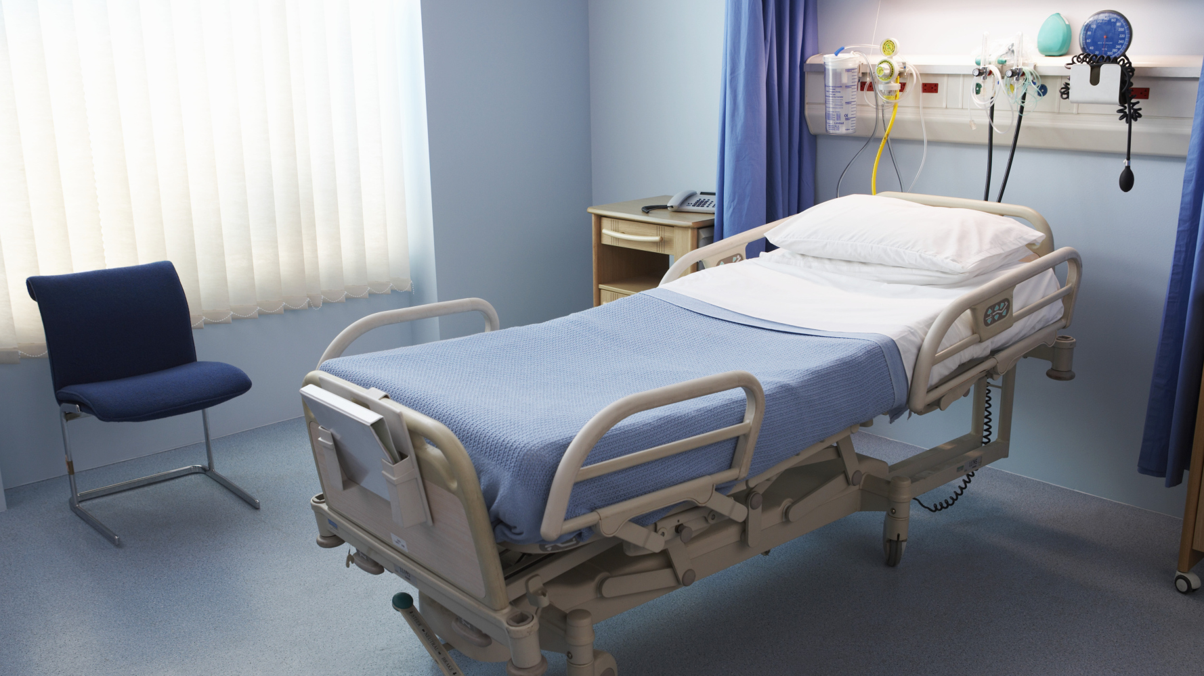
DharaMitra:
Revolutionizing post-
surgery care with AI
ThePhoto by PhotoAuthor is licensed under CCYYSA.

Slide 2
Critical Gaps in Post-Surgery Care for
Patients and Doctors
Where recovery fails: visibility, guidance, and continuity break down after discharge​
Post-surgery patients lack continuous support.
Patients miss early signs of infection at home.
Discharge summaries are confusing and hard to follow.
Doctors have no visibility into home-based recovery.
Post-operative care is fragmented and unstructured.

Slide 3

Key features that detect risks early,
simplify care, and guide recovery
ThePhoto by PhotoAuthor is licensed under CCYYSA.

Slide 4
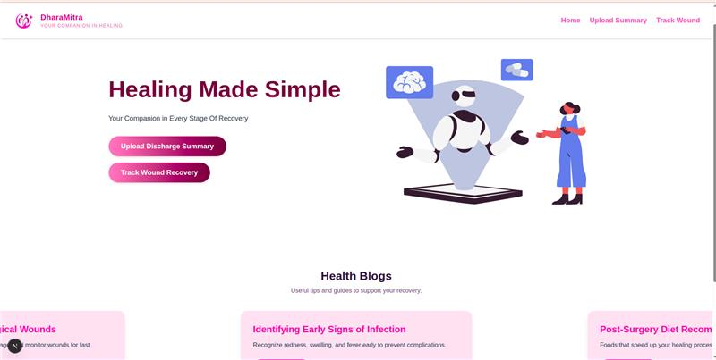
Daily recovery dashboard with guided
instructions.
Alerts and reminders for tasks, meds, and risk signs.

Slide 5
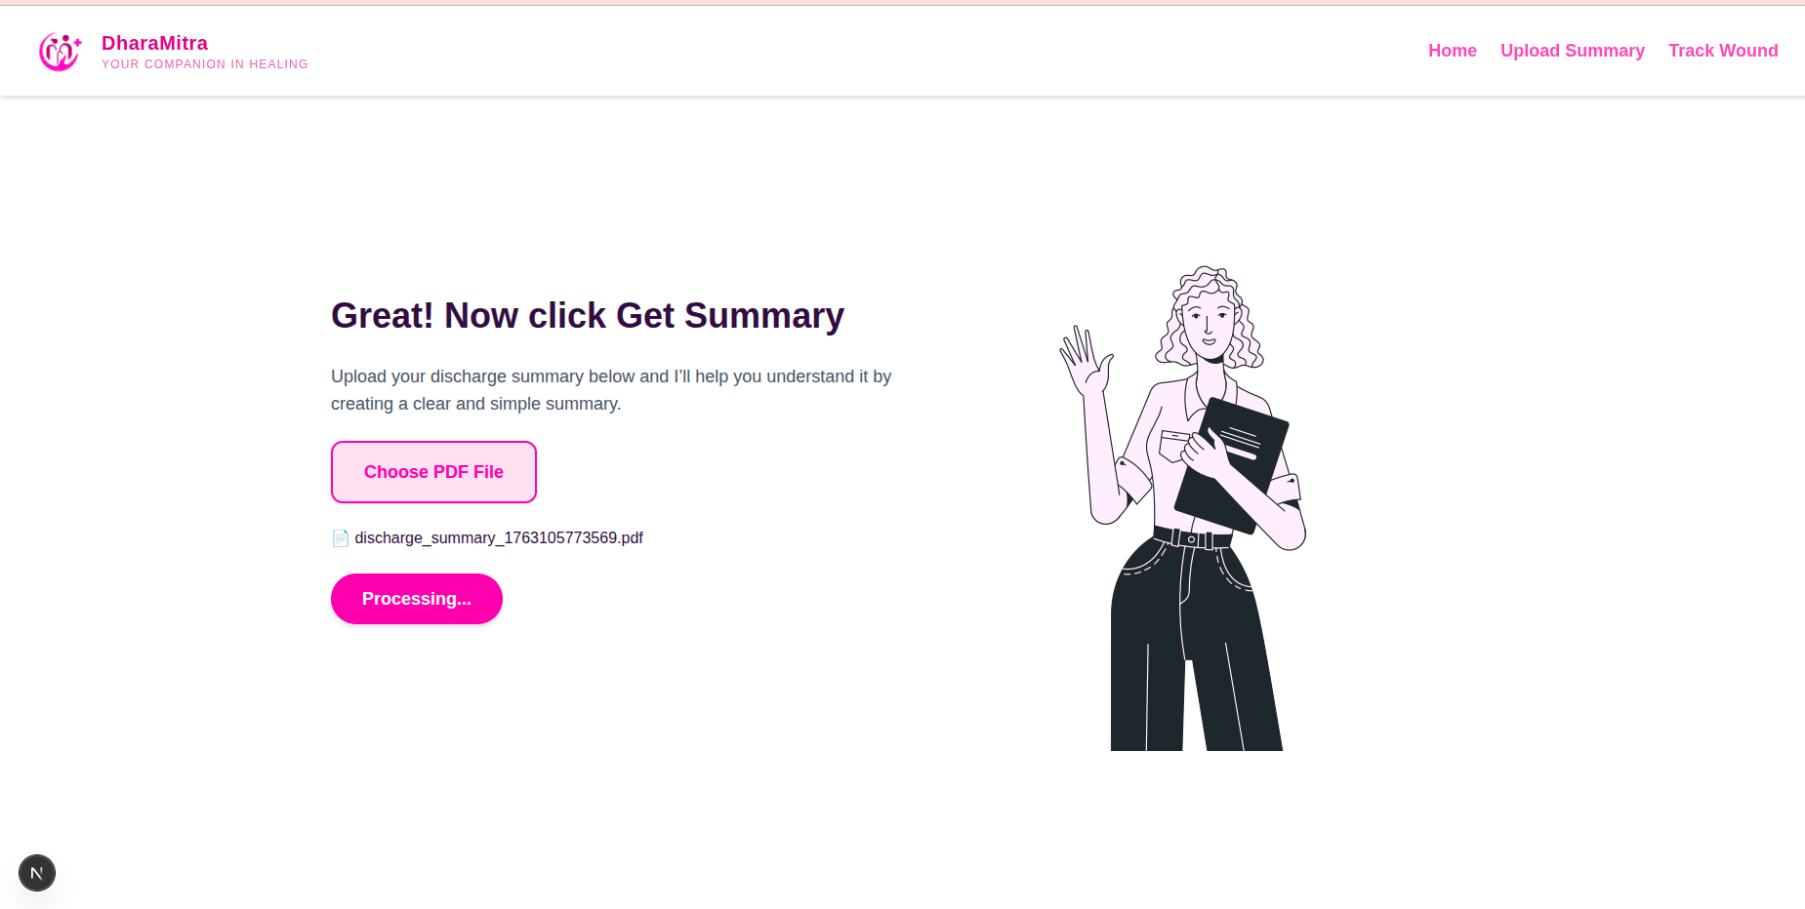
Clean, simplified discharge summaries.

Slide 6
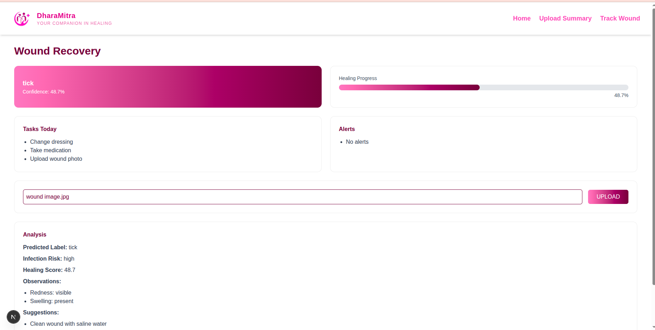
AI-based wound photo analysis for
early issue detection.
Healing timeline with visual wound progression.

Slide 7

Healthcare Impact

Slide 8
Quantified outcomes that reduce complications, readmissions, and improve satisfaction
Early detection reduces complications by 30–40%.
Lowers readmission rates and emergency visits.
Provides surgeons with real-world outcome data.
Improves patient confidence and satisfaction.
Standardizes post-surgery care workflows.

Slide 9
Future Scope
Upcoming features to expand clinical automation, analytics, and integration for smarter recovery workflows
AI complication prediction engine.
Multi-specialty automated recovery pathways.
Doctor outcome analytics platform.
Digital dressing assistant module.
Hospital EMR integration for smart discharge.
AI-driven wound healing research tools.

Slide 10

Monetizing Across Hospitals, Doctors and Patients
B2B: Hospital subscriptions for monitoring & dashboards.
B2D: Doctor premium analytics and follow-up tools.
B2C: Patient premium AI insights and recovery
predictions.
White-label customization for hospitals & surgical centers.
Enterprise EMR/API integration fees.

Slide 11
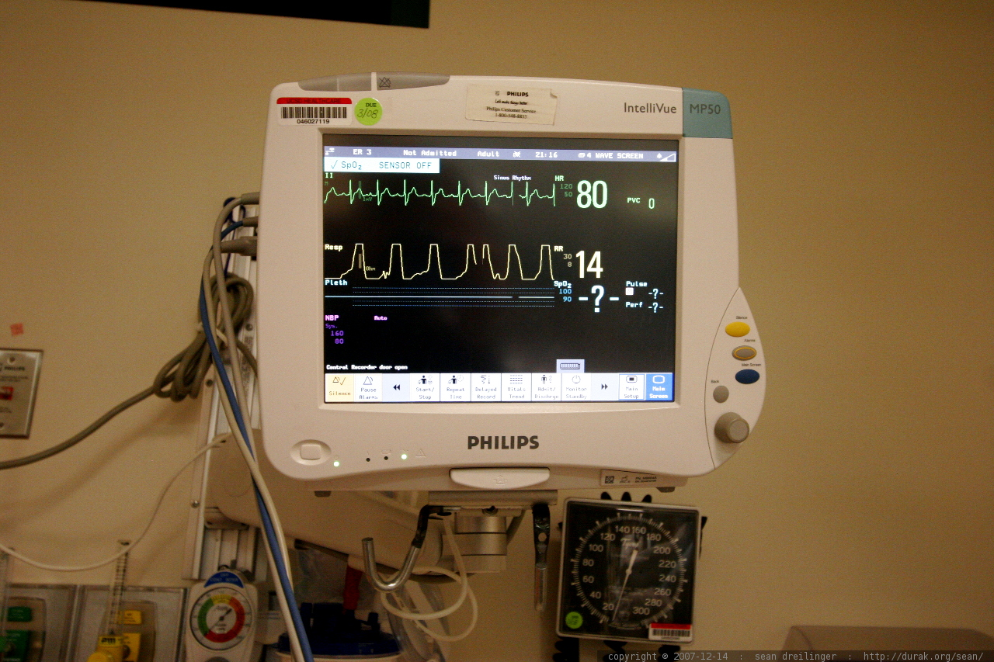


THANK YOU

